Slide 1
Recommender Systems – An Introduction Dietmar Jannach, Markus Zanker, Alexander Felfernig, Gerhard Friedrich Cambridge University Press
http://www.recommenderbook.net/teaching-material/slides
Which digital camera should I buy? What is the best holiday for me and my family? Which is the best investment for supporting the education of my children? Which movie should I rent? Which web sites will I find interesting? Which book should I buy for my next vacation? Which degree and university are the best for my future?

Slide 2
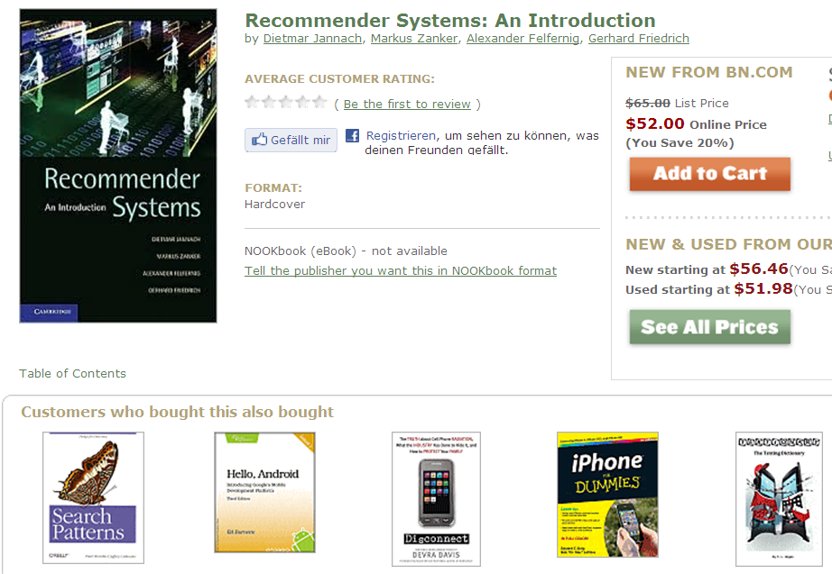

Slide 3
Agenda
Introduction
Problem domain
Purpose and success criteria
Paradigms of recommender systems
Collaborative Filtering
Content-based Filtering
Knowledge-Based Recommendations
Hybridization Strategies

Slide 4

Introduction

Slide 5



Problem domain
Recommendation systems (RS) help to match users with items
Ease information overload
Sales assistance (guidance, advisory, persuasion,…)
RS are software agents that elicit the interests and preferences of individual consumers […] and make recommendations accordingly.
They have the potential to support and improve the quality of the decisions consumers make while searching for and selecting products online.
(Xiao & Benbasat 2007¹)
Different system designs / paradigms
Based on availability of exploitable data
Implicit and explicit user feedback
Domain characteristics
(1) Xiao and Benbasat, E-commerce product recommendation agents: Use, characteristics, and impact, MIS Quarterly 31 (2007), no. 1, 137–209

Slide 6
Purpose and success criteria (1)
Different perspectives/aspects
Depends on domain and purpose
No holistic evaluation scenario exists
Retrieval perspective
Reduce search costs
Provide "correct" proposals
Users know in advance what they want
Recommendation perspective
Serendipity – identify items from the Long Tail
Users did not know about existence
Notes:
Could a RS be a persuasive technology? In fact depending on the application area RS are deployed to:

Slide 7
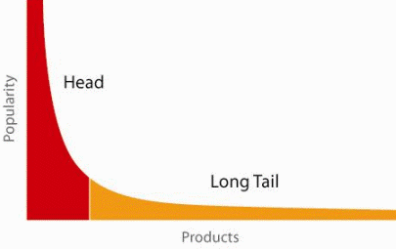
When does a RS do its job well?
"Recommend widely unknown items that users might actually like!"
20% of items accumulate 74% of all positive ratings
Items rated > 3 in MovieLens 100K dataset
Recommend items from the long tail

Slide 8
Purpose and success criteria (2)
Prediction perspective
Predict to what degree users like an item
Most popular evaluation scenario in research
Interaction perspective
Give users a "good feeling"
Educate users about the product domain
Convince/persuade users - explain
Finally, conversion perspective
Commercial situations
Increase "hit", "clickthrough", "lookers to bookers" rates
Optimize sales margins and profit

Slide 9
Recommender systems
RS seen as a function
Given:
User model (e.g. ratings, preferences, demographics, situational context)
Items (with or without description of item characteristics)
Find:
Relevance score. Used for ranking.
Relation to Information Retrieval:
IR is finding material [..] of an unstructured nature [..] that satisfies an information need from within large collections [..].
(Manning et al. 2008¹)
(1) Manning, Raghavan, and Schütze, Introduction to information retrieval, Cambridge University Press, 2008

Slide 10
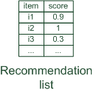
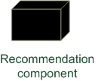
Paradigms of recommender systems
Recommender systems reduce information overload by estimating relevance

Slide 11


Paradigms of recommender systems
Personalized recommendations

Slide 12

Paradigms of recommender systems
Collaborative: "Tell me what's popular among my peers"

Slide 13

Paradigms of recommender systems
Content-based: "Show me more of the same what I've liked"

Slide 14


Paradigms of recommender systems
Knowledge-based: "Tell me what fits based on my needs"

Slide 15
Paradigms of recommender systems
Hybrid: combinations of various inputs and/or composition of different mechanism

Slide 16
Outlook
Part I (Basic Concepts)
Basic paradigms of collaborative,
content-based, and
knowledge-based recommendation,
as well as hybridization methods.
Explaining the reasons for recommending an item
Experimental evaluation
Part II (Recent Research Topics)
How to cope with efforts to attack and manipulate a recommender system from outside,
supporting consumer decision making and
potential persuasion strategies,
recommendation systems in the context of the social and semantic webs, and
the application of recommender systems to ubiquitous domains

